Slide 1
Self care and coping skills
Presented by Consuelo Torres, LCSW

Slide 2
Self Care Positive affirmations
Why feelings are important:
It is helpful to appreciate the positive role feelings play in our life.
The more we are able to align our feelings with a positive understanding of what they can do for us the more we can try trusting them to carry us forward in our lives.
Something to think about: Am I allowing my feelings a chance to support new growth and learning in my life??
What are my feelings telling me about my relationships??
Psychcentral.com/lib/why-are-feelings-important
I am enough
I am the best parent for my child
I am stronger than I know
I am open to learning new things
I am modeling self-love, self respect, and healthy coping skills for my children by practicing self-care
I am worthy to receive the help of others
Parentselfcare.com

Slide 3
Self-Care ideas: Coloring, painting, arts and crafts journaling watch a funny movie dance and sing stay hydrated meditate Get 7-9 hours of sleep per night ask for help read do a puzzle reach out to a loved one spend time in nature listen to music focus on projects that energize you take a walk pArentselfcare.com

Slide 4
Coping skills
How to support our kids during the COVID-19 pandemic:
Encourage kids to express sad, mad, happy or hard feelings.
Move and play
Slow down or stop
Give hugs
Make eye contact
Say sorry
ACES Connection, Yolo County Children’s Alliance, Essentials for Childhood and CDPH
*Take a break
*Play a game
*Practice deep breathing and slow breathing
*Play sports
*Talk to someone you trust
*Write a list of goals
*Role play challenging situations with others
*Set boundaries
*Write a list of strengths
PositivePsychology.com

Slide 5
Children's Books and books for parents
Breathe Like a Bear by Kira Willey
Grumpy Monkey by Suzanne Lang
Personal Space Camp by Julia Cook
The 5 Love Languages of Children by Gary Chapman and Ross Campbell
How to Talk So Kids Will Listen…And Listen So Kids Will Talk by Adele Faber and Elaine Mazlish
Siblings without Rivalry: How to Help Your Children Live Together So You Can Too by Adele Faber and Elaine Mazlish
Parentselfcare.com

Slide 6
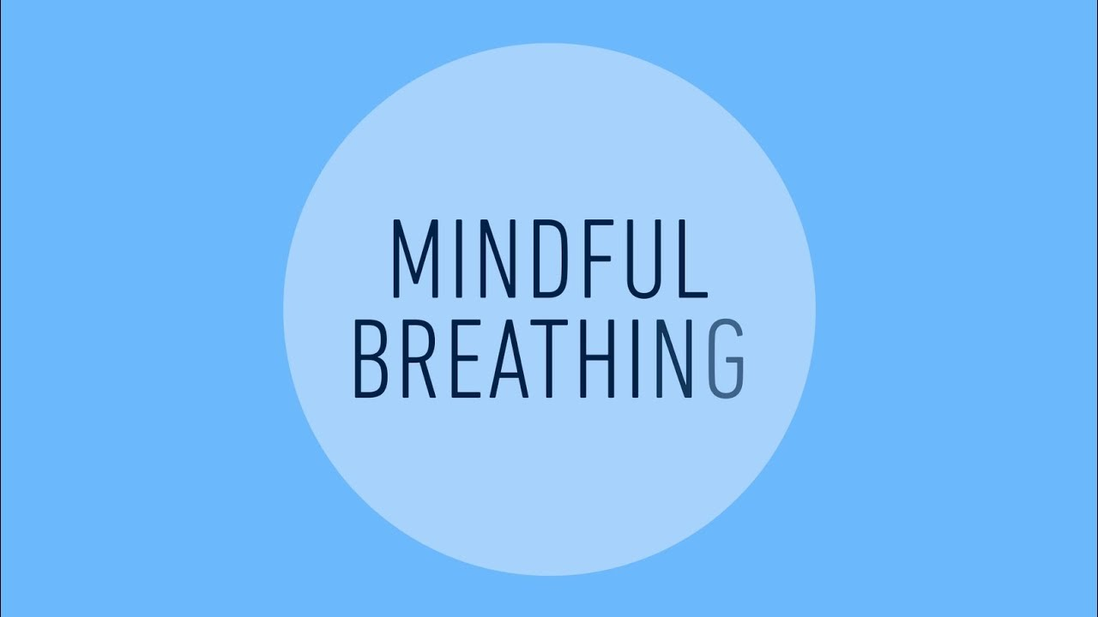
My self care menu
List 5 things that bring you joy
List 5 movies or tv shows that make you laugh or feel calm
List 5 songs that boost your mood or help you relax
List 5 things that you can do to be active/ move your body
List 5 ways that you can show yourself kindness
List 5 things that you are grateful for
List 5 things that help you to relax before bedtime
List 5 people that make you feel happy
Parentselfcare.com

Slide 7
Thank you
Credits:
Parentselfcare.com
Psychcentral.com/lib/why-are-feelings-important
Positivepsychology.com
ACES Connection, Yolo County Children’s Alliance, Essentials for Childhood and CDPH
Images from Google

